Slide 1
Children’s Literature
Evaluation Criteria for Informational Books

Slide 2
Accuracy and Style: How They Croaked
Right from the introduction itself, the style of this author’s writing shines through. In the introduction Bragg posts a warning to steer readers away from the book if they “…don’t have the guts for gore,” basically assuring kids will not want to put this book down. Although the subject matter is definitely macabre, the author keeps a light, humorous tone throughout, and though each story is loaded with information backed up by numerous sources (8 pages worth), the individual vignettes don’t get bogged down in the details. The amount of research shown to complete this book is impressive, and also lends itself toward a definite show of accuracy.

Slide 3
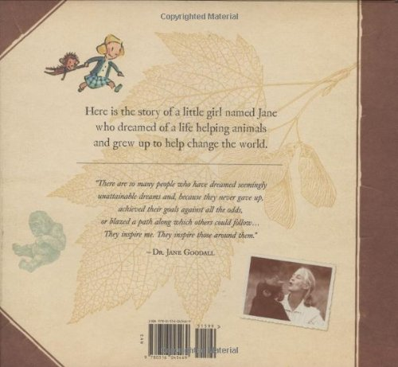
Design: Me…Jane
Me…Jane has the inviting look and feel of a children’s picture book, but it is actually a biography sharing Jane Goodall’s early years. The author carefully incorporates primary source documents from Goodall’s childhood along with delightful, whimsical drawings. Children won’t need to shy away from this biography as being dry or boring, but chances are they will want to read the “About Jane Goodall” and the “Message from Jane” sections at the end, and they may even follow the URLs provided to find out more information for themselves.
lala

Slide 4
Organization and Accuracy: Balloons over Broadway
This book wastes no space when it comes to sharing the real-life story of Tony Sarg and the creation of the Macy’s day parade balloons. The information literally begins right inside the front cover, and the delightful flow continues through to the primary document (an original parade announcement from the New York Times) inside the back cover. Inside this book you find not only a lively biography of Tony Sarg, but readers are treated to a combination of Melissa Sweet’s illustrations and collages. Sweet brings it all together to share the story of one man’s passion to bring his puppetry to the masses. At the end, readers are treated to an Author’s Note which offers even more details about the “father of American puppetry,” and they may come to realize that without Sarg, beloved childhood characters such as the Muppets may never have existed. All this information is backed up by a solid bibliography and source notes, so readers can feel confident about the accuracy and the research behind what they have just read.

Slide 5
Style: Rosa
The next time someone tries to tell you a nonfiction book can’t be a work of literature, hand them a copy of Rosa by Nikki Giovanni. This book is a passionate retelling of the story of Rosa Parks and the beginning of the Montgomery Bus Boycott. Readers will appreciate how real Giovanni and the illustrator, Brian Collier, make that day feel for them. Also, readers are allowed to see how this one act of defiance led to something much bigger that changed our country for the better. Between Giovanni’s lyrical writing style, Collier’s striking illustrations, and direct quotations from Dr. Martin Luther King, Jr., this book becomes much more than a dry piece of nonfiction; it is definitely an artistic slice of American history.

Slide 6
Design and Style: We Are the Ship
The author of We Are the Ship, Kadir Nelson, offers up a unique look at the early days of baseball for African Americans. The writing style of this book takes a distinctive turn through the author’s choice to use a single voice to tell the story, and the choice to include the author’s paintings of these ball players heightens that stylistic decision.
It is a nice surprise to find the giant foldout ticket for the “First Colored World’s Series” added in at the end of the 1st Inning chapter, and when the ticket is opened, the reader is treated to a painting of the two teams. The writing maintains a high level of interest, and a personal, almost intimate, manner throughout. It almost feels like you are sitting on a porch listening to these stories being told by someone who was there.

Slide 7
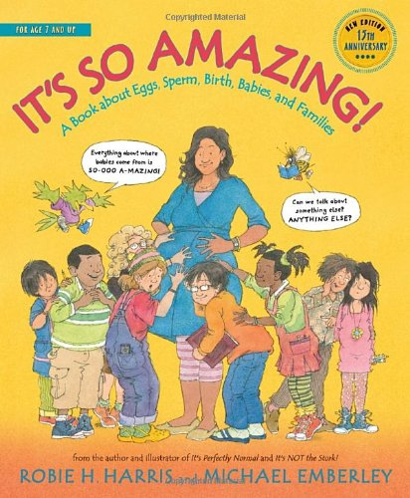
Accuracy and Organization: It’s So Amazing!
It is hard to imagine a book you would want to make sure of the accuracy of its information more than one about how babies are made. The writing and illustrations in this book are fun and inviting, with two crazy little characters, a bird and a bee, commenting on the factual data throughout. These characters also bring up questions children may wonder about, and repeat often that it is perfectly normal to be curious about how our bodies function. While there is a definite sequence to the material, this book doesn’t have to be read from front to back; topics are separated into chapters with both fun titles and practical subtitles listed in the table of contents. To make sure the data is correct, the author consulted with a massive list of medical professionals.
While the animals in the book do talk to us (as well as the eggs and sperm in many drawings), facts are clearly differentiated from the fun side, and this book should be able to handle many questions about the subject that a child may have but not be willing or able to talk to an adult about yet.

Slide 8
Accuracy and Design: Butterflies and Moths
Nic Bishop’s book Butterflies and Moths is not just full of information about these creatures, but each facing page has a new and beautiful picture of a different butterfly or moth. Each photo is accompanied by a caption which gives the name and some information about the particular insect, and then the caption describes how much larger the shown picture is as compared to actual size. At the end Bishop describes what it was like to work photographing this book. He tells readers that some of the pictures took up to weeks to capture perfectly, and one, the “snakelike caterpillar,” is so rare that it actually took several years for him to get a photograph. His dedication to his field of study as well as his knowledge shine through on each page, and his eye for details like solid colors and bold fonts to set off the butterfly and moth pictures adds to the perfection.

Slide 9
Style: Primates
Writing Primates in a graphic novel style is nothing short of brilliant when it comes to attracting a young audience to this topic. The author of the book keeps the stories of these three women light and humorous when possible, but he doesn’t skip over the hard details such as illness, loneliness, and even losing loved ones to divorce or poachers. The graphic novel approach keeps readers moving through at a good pace, and where the words don’t give enough detail, the illustrations fill the gaps. Best of all, Primate doesn’t share too much information—it is more of an overview of these women’s lives—but it does give enough to pique interest, and offers young readers an idea where to look for more on this topic.

